Slide 1
String Searching Algorithms

Slide 2
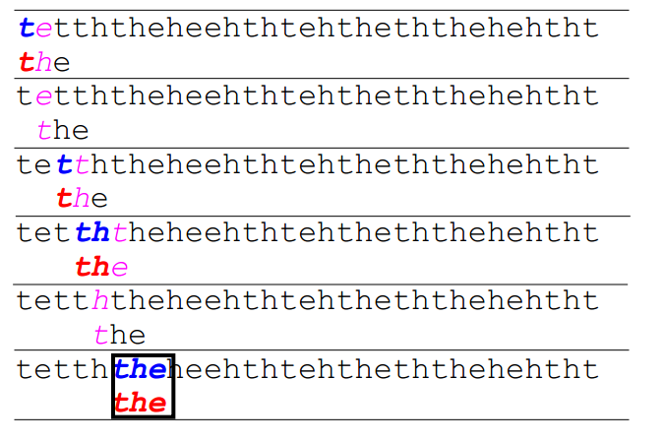
Brute Force

Slide 3
do
if (text letter == pattern letter)
compare next letter of pattern to next letter of text
else
move pattern down text by one letter
while (entire pattern found OR end of text)

Slide 4
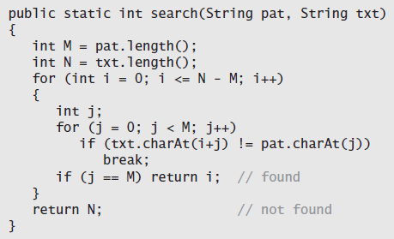

Slide 5
Brute-force substring search requires ~NM character compares to search for a pattern of length M in a text of length N, in the worst case. (next slide)
If none of the characters are in the search string, then the worst case is N.
Brute force algorithms requires us to back up in the text when we find a mismatch.

Slide 6
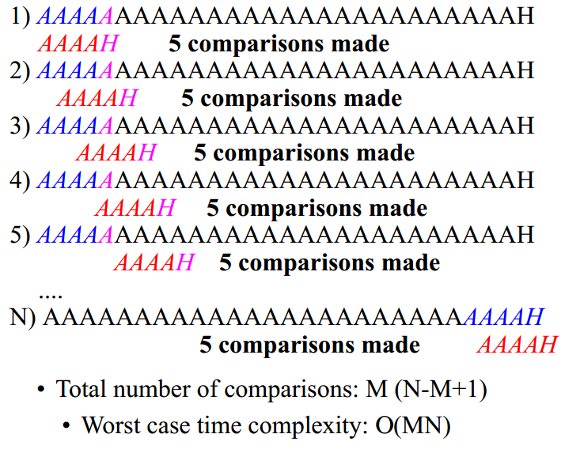

Slide 7
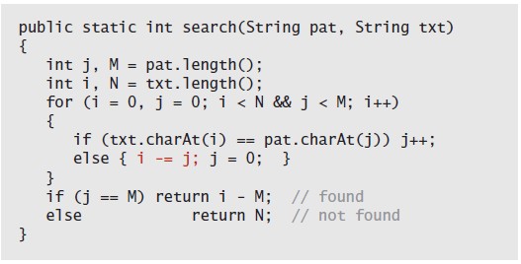

Slide 8
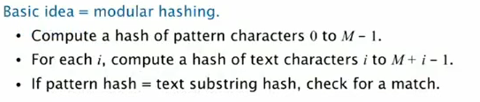
Rabin-Karp fingerprint search
We need a hash function to convert an M-digit base-R number to an int value between 0 and Q-1. Modular hashing provides an answer.
We use a random prime Q, taking as large a value as possible while avoiding overflow.

Slide 9
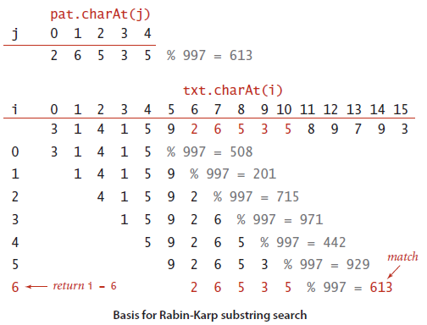
Basis

Slide 10
But, computing a hash function that involves every character is likely to be much more expensive than just comparing characters.
Also, our pattern won’t always be equal to 5 digits.
It may be equal to 100 digits.
So (Number) % 997 would fail in this case.
So we use a method called Horner’s method.

Slide 11
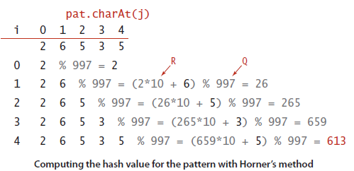
2*10,000 + 6*1000 + 5*100 + 3*10 + 5*1 = 26535
So one problem solved.
But still, computing hash for M characters from the input text will still be quite expensive.

Slide 12
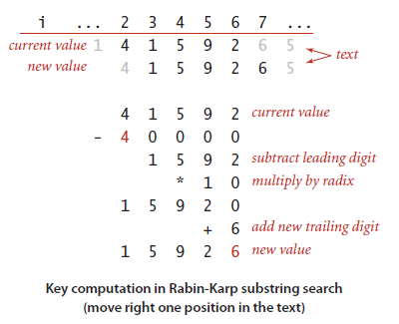
The Rabin-Karp method is based on efficiently computing the hash function for position i+1 in the text, given its value for position i.
We subtract off the leading digit, multiply by R, then add the trailing digit.

Slide 13
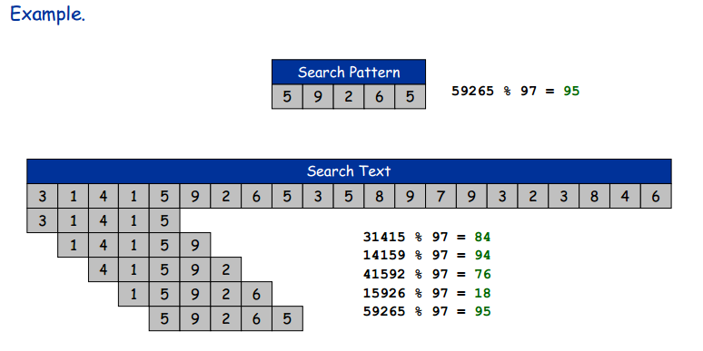
Example

Slide 14
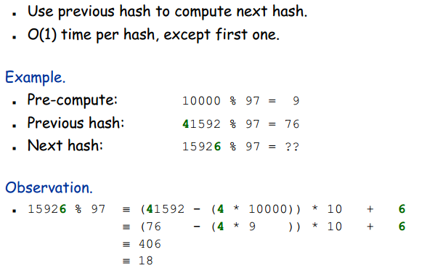
(subtract off the leading digit, multiply by R, then add the trailing digit.)
Rabin Karp

Slide 15
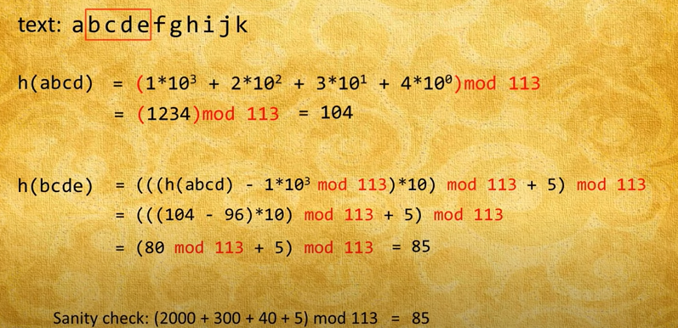
Sanity Check

